Slide 1
以下四页为报告要求

Slide 2
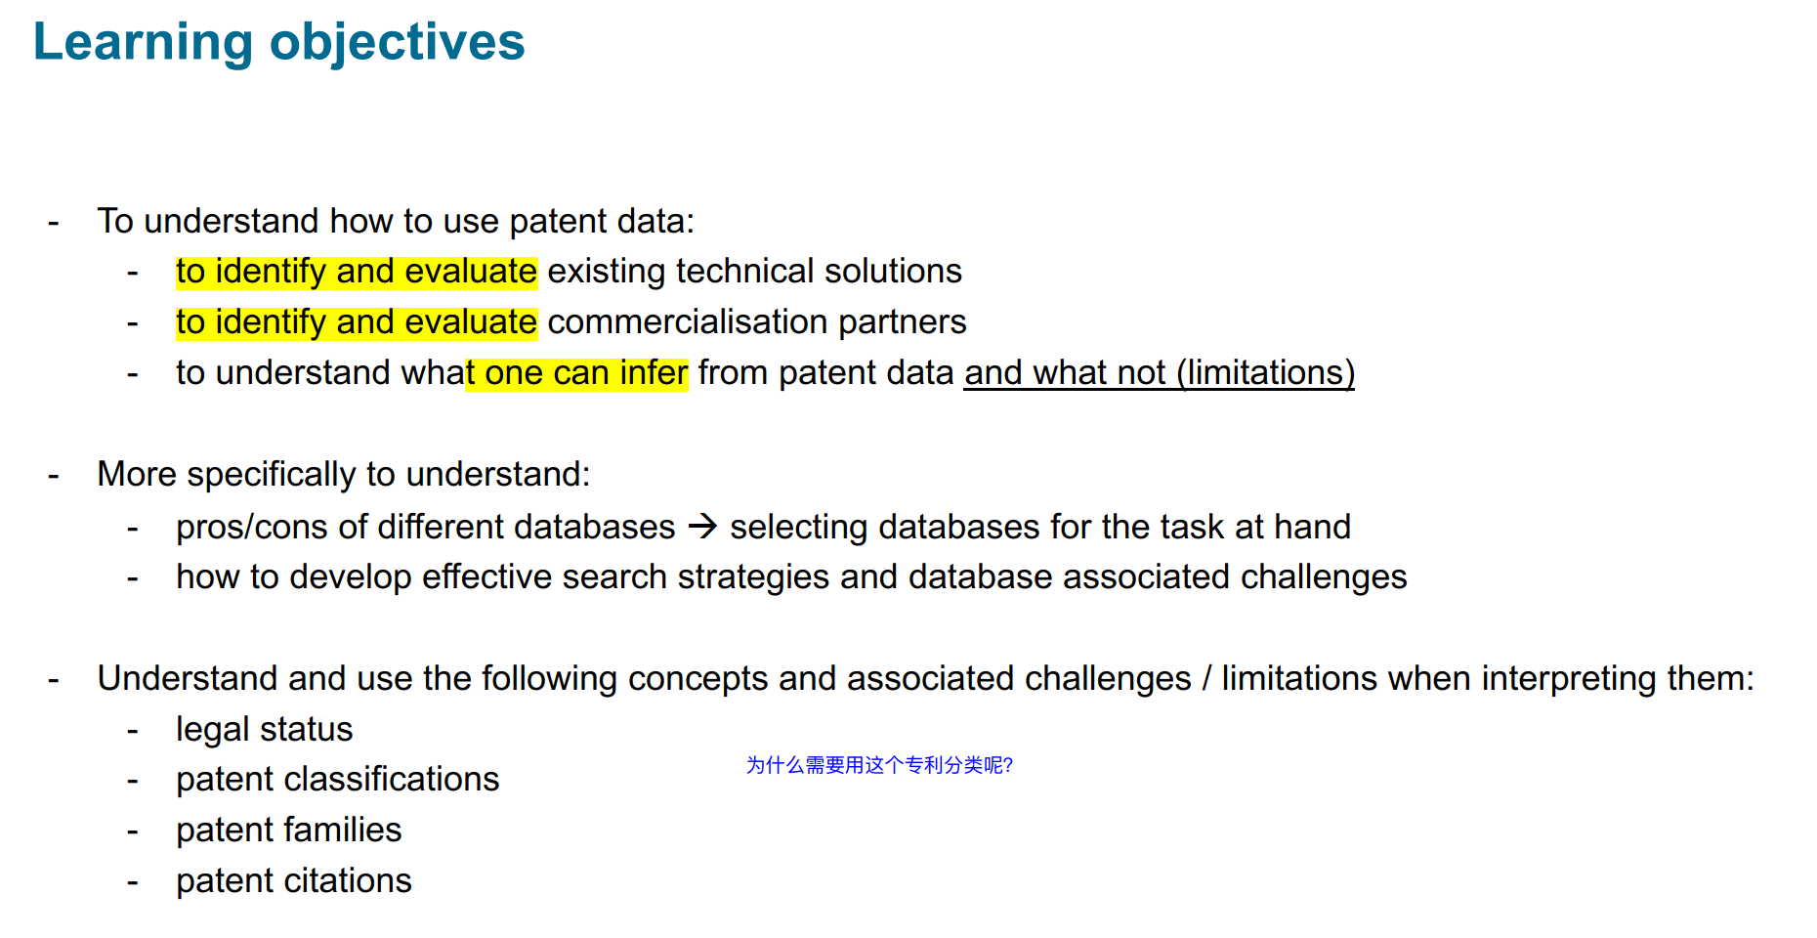
Final presentation
How to identify
How to evaluate
Limitation:
The real value of a patent
Still have to really look
这四个标准很重要

Slide 3
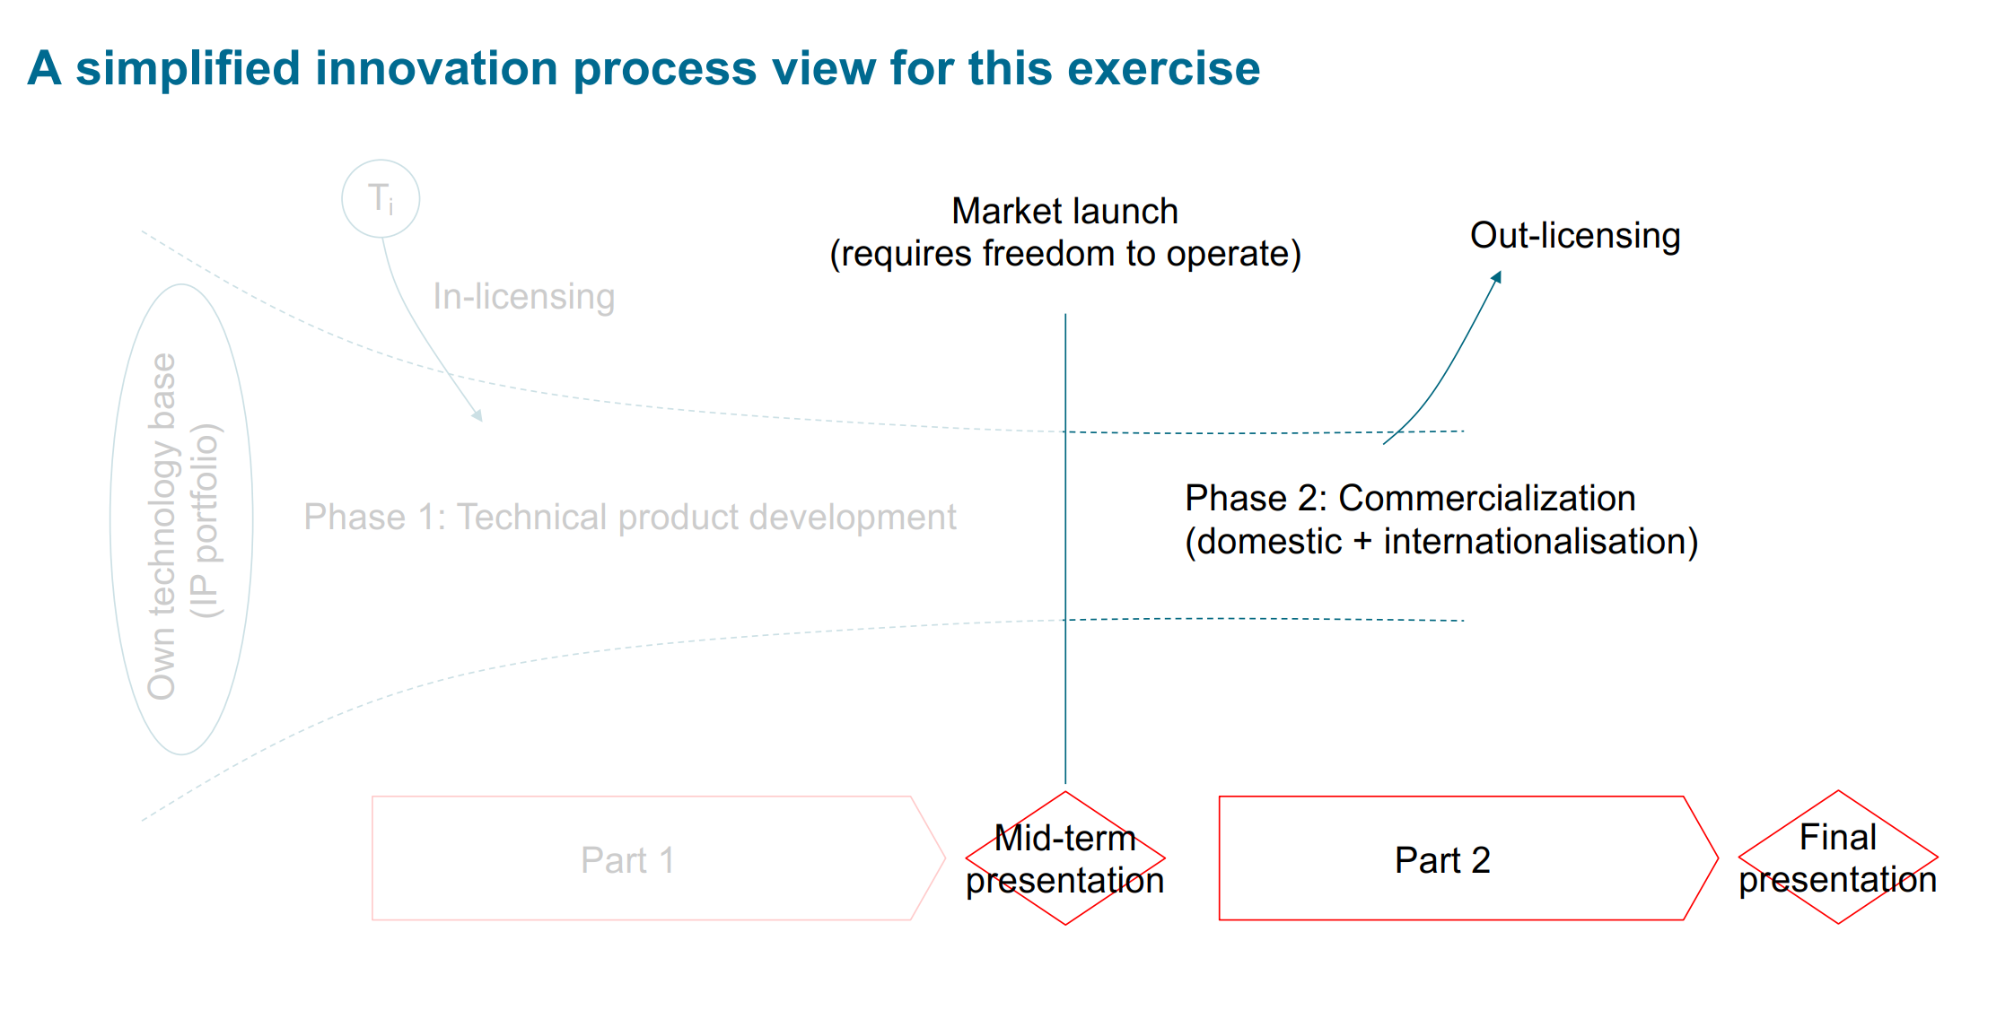
问题是：
怎么选出合适的专利呢？
怎么实现国际化？

Slide 4
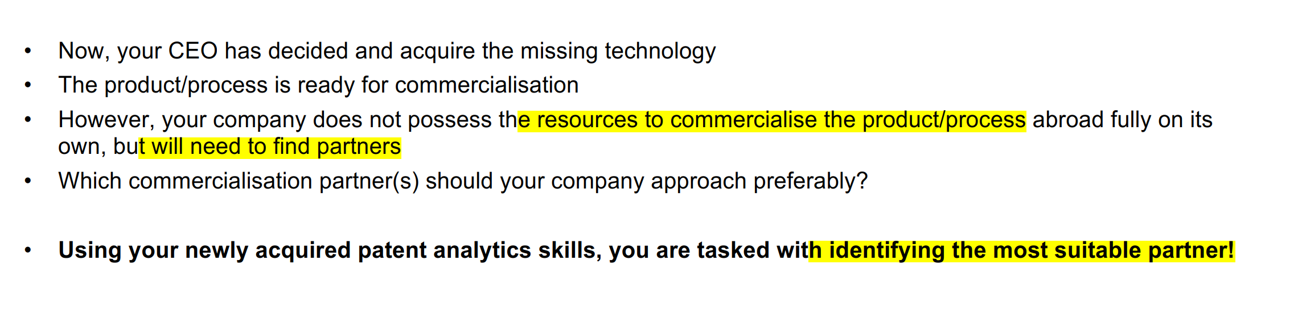
我们的任务：找朋友

Slide 5
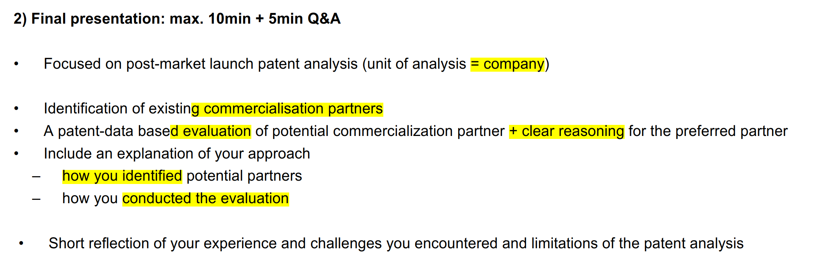
报告内容
✔️
重点：
这次把评估体系好好研究一下！！！

Slide 6
Prepreparation for final Pre
此页为正式报告
2022-02-23

Slide 7
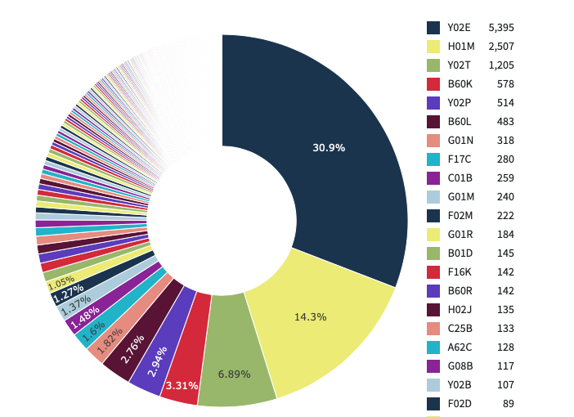
Five Selected CPC
Y02E | Reduction of greenhouse gas emissions, related to energy generation, transmission or distribution
H01M | Processes or means, e.g. Batteries, for the direct conversion of chemical energy into electrical energy
Y02T | Climate change mitigation technologies related to transportation
B60K | Arrangement or mounting of propulsion units or of transmissions in vehicles; arrangement or mounting of plural diverse prime-movers in vehicles; auxiliary drives for vehicles; instrumentation or dashboards for vehicles; arrangements in connection with cooling, air intake, gas exhaust or fuel supply of propulsion units in vehicles
Y02P | Climate change mitigation technologies in the production or processing of goods
The top six accounted for around 60%

Slide 8
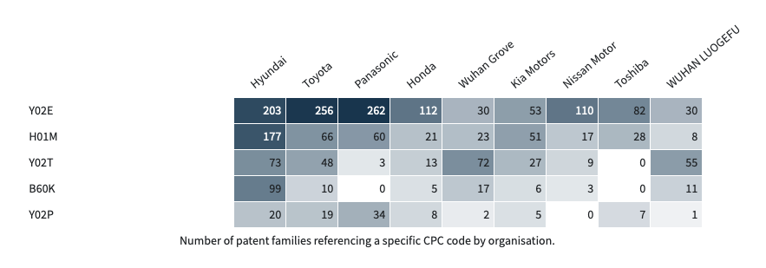
Our partners based on CPC
Table: Number of patent families referencing a specific CPC code by organization.
Self define
>100
>50
>40
>=10
>=10
Total
5
5
3
1
2
1
1
0
2
Conclusion
How to choose?
Complementary Companies:
Technology Complementation
Similar Companies:
More advanced technologies
All-rounder companies: Hyundai & Toyota
Expert in Y02T: Wuhan Grove
Expert in Y02P: Panasonic

Slide 9
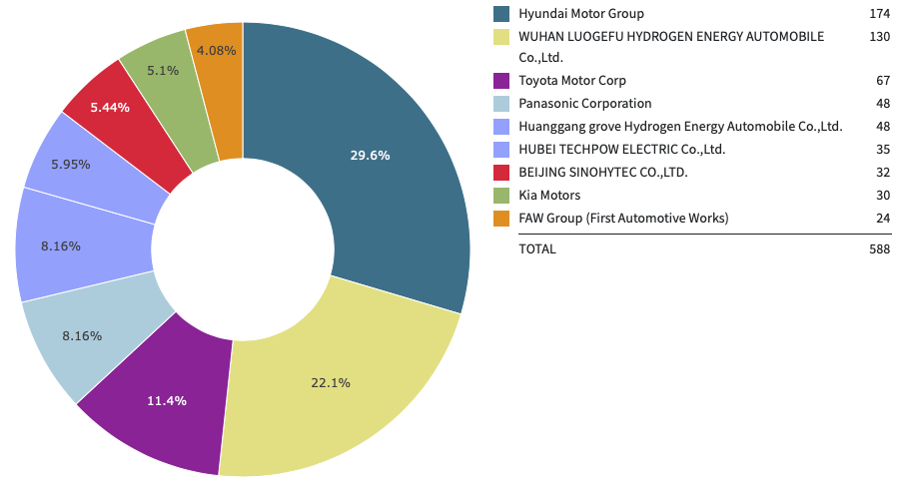
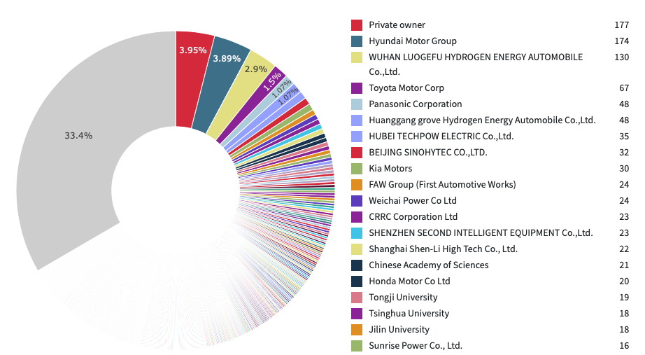
Our partners based on Granted Patents
The top nine accounted for 13.1%
Private owner
Next
Figure 2. Currently granted patent families by organization in Top 10 apart from Private owner.
Conclusion
First choices (Granted patents>100): Hyundai Motor Group & Wuhan Luogefu Hydrogen Energy Automobile Co., Ltd.
Figure 1. Currently granted patent families by organization in total.
Second choices (Granted patents 50~100) :Toyota Motor Group

Slide 10
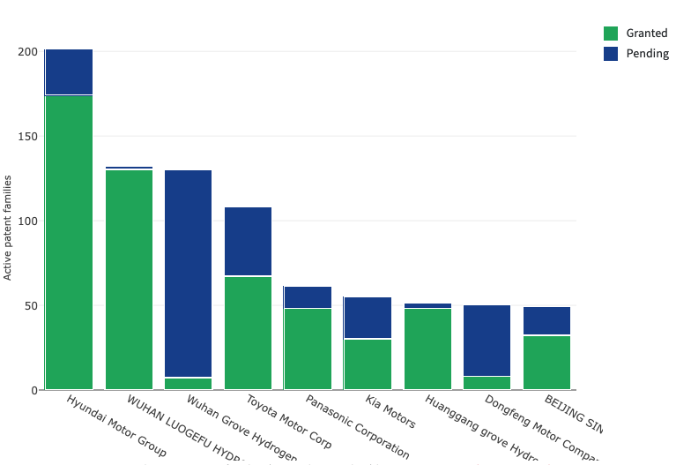
Our partners based on Granted/Pending ratio
去掉最具有潜力的，这样分析有问题
Why pending?
具体看
644%
Most promising partners (Granted/Pending ratio<20%):
Wuhan Grove Hydrogen & Dongfeng Motor Company
Highly developed partners (Granted/Pending ratio>500%):
Huangang grove Hydrogen & Hyundai Motor Group & Wuhan Luogefu Hydrogen
650%
5.7%
163%
369%
120%
1600%
19%
188%
有的pending可能是不错的
Figure 1. Currently active patent families (granted vs pending) by organization.

Slide 11
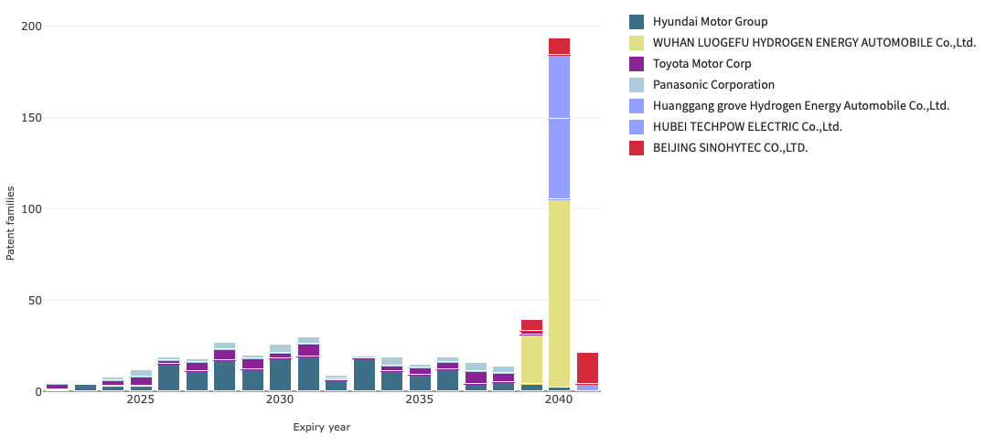
Our partners based on Granted/Pending ratio
Expiry date>18 years:
Wuhan Luogefu Hydrogen
Huangang Grove Hydrogen
Hubei Tech
Beijing Sinohytec
结论：从 Age of portfolio角度，该如何选择好伙伴呢？年限越大，后面可利用的时间就相对变短。但同时也意味这这家公司开始从业早，技术成熟。
Figure 1. Projected number of patent families expiring per year, for each organization. Only considers currently granted patent families and assumes patent families reach a maximum age of 20 years.

Slide 12
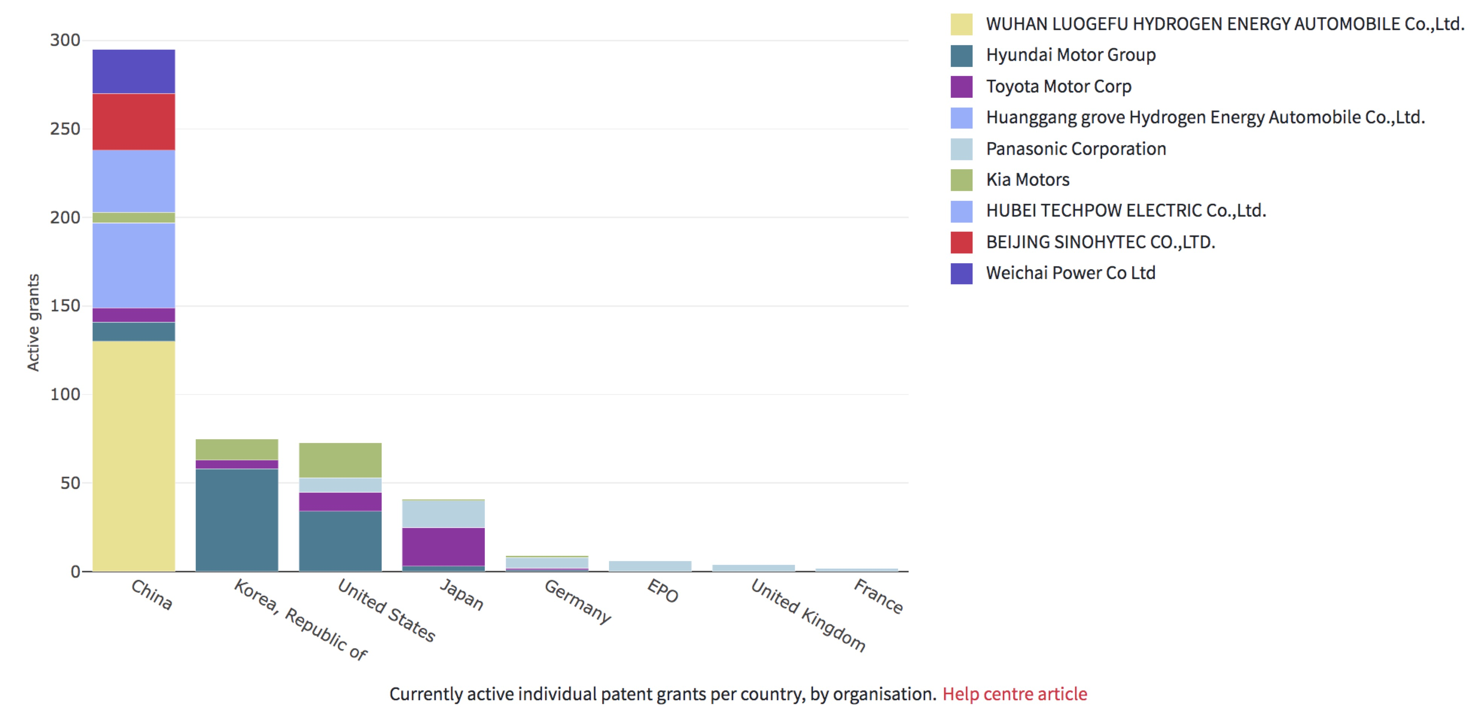
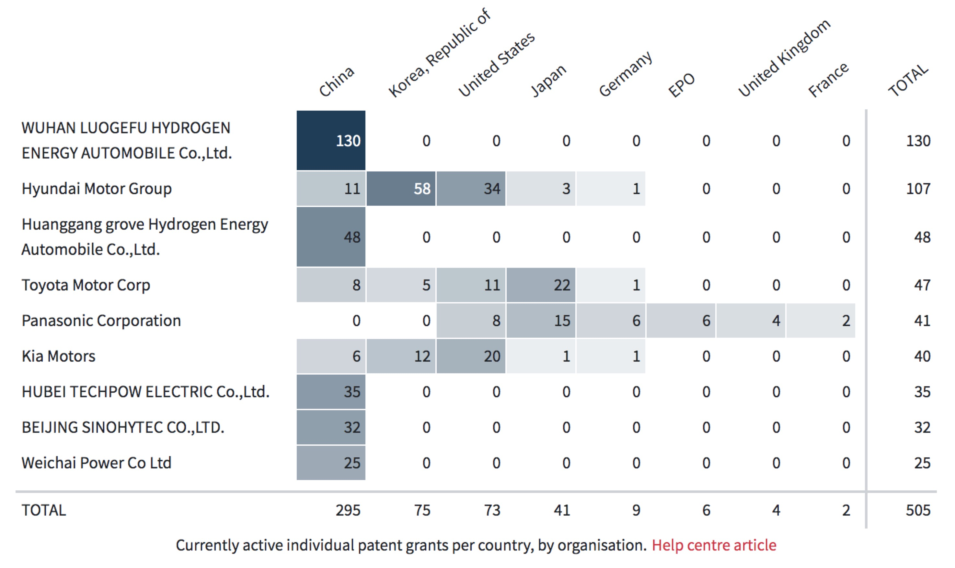
Patent family & geography
Weight: 0.7 | Active grants in ≥ 5 countries | 5 > Active grants in ≥ 4 countries | 4 > Active grants in ≥ 3 countries | 3 > Active grants in ≥ 2 countries | 2 > Active grants in ≥ 1 countries
Country score | 5 | 4 | 3 | 2 | 1
Weight: 0.3 | Active grants ≥ 50 | 50 > Active grants ≥ 45 | 45 > Active grants ≥ 40 | 40 > Active grants ≥ 35 | 45 > Active grants ≥ 30
Patent score | 5 | 4 | 3 | 2 | 1
 | Hyundai | Toyota | Panasonic | Kia | Wuhan Luogefu
Total score | 5 | 4.7 | 4.4 | 4.4 | 2.2
Rank | 1 | 2 | 3 | 4 | 5
The rank is based more on the number of countries and less on the number of patents.
priority day in 10ys

Slide 13
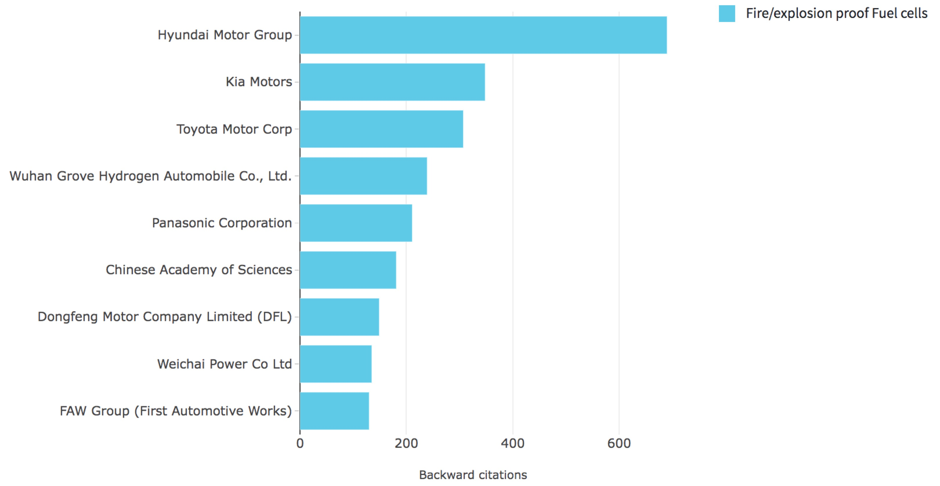
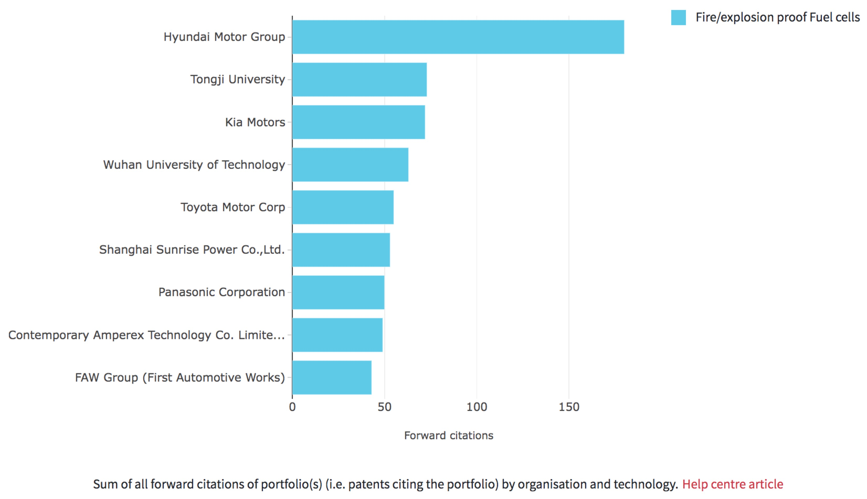
Patent family & citations
Weight: 0.2 | Citation ≥ 600 | 600 > Citation ≥ 340 | 340 > Citation ≥ 300 | 300 > Citation ≥ 200 | 200 > Citation ≥ 100
Backward citation score | 5 | 4 | 3 | 2 | 1
Weight: 0.8 | Citation ≥ 100 | 100 > Citation ≥ 70 | 70 > Citation ≥ 55 | 55 > Citation ≥ 50 | 50 > Citation ≥ 40
Forward citation score | 5 | 4 | 3 | 2 | 1
 | Hyundai | Kia | Toyota | Panasonic | FAW
Total score | 5 | 4 | 3 | 2 | 1
Rank | 1 | 2 | 3 | 4 | 5
The rank is based more on the number of forward citations and less on the number of backward citations.
Forward citation means fundamentality and originality.
Backward citation means continuity.
priority day in 10ys

Slide 14
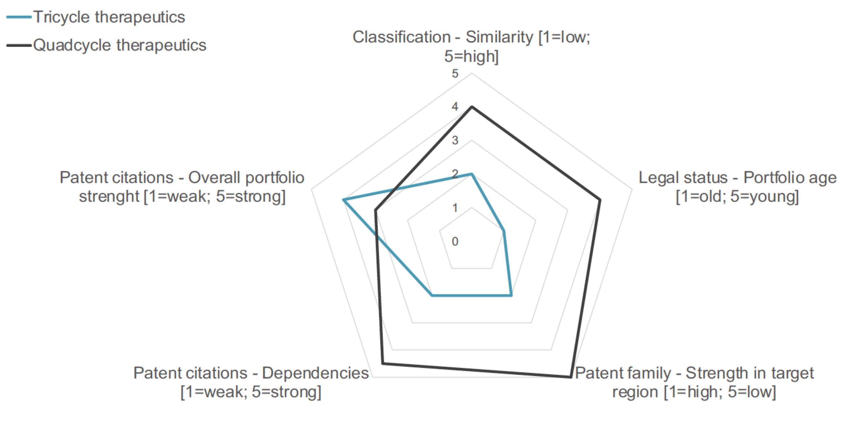
Results of multidimensional partner fit evaluation
Weight: 0.3 | Toyota | Hyundai | Kia | Panasonic | Wuhan Luogefu /FAW
Similarity score | 5 | 4 | 3 | 2 | 1
Weight: 0.7 | Toyota | Hyundai | Panasonic | Kia | Wuhan Luogefu /FAW
Complementarity score | 5 | 4 | 3 | 2 | 1
Classification - matching degree
Similarity:
industry/domain [1~5]
Weight coefficient: 0.3
Complementarity: function/expertise[1~5]
Weight coefficient: 0.7
 | Toyota | Hyundai | Panasonic | Kia | Wuhan Luogefu /FAW
Total score | 5 | 4 | 3 | 2 | 1
Rank | 1 | 2 | 3 | 4 | 5

Slide 15
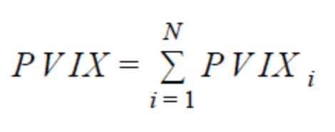
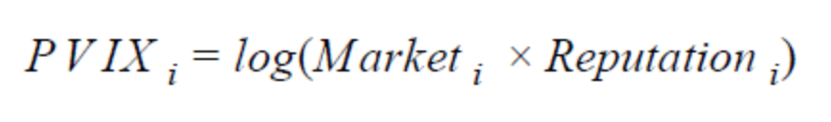
PVIX定义

Slide 16
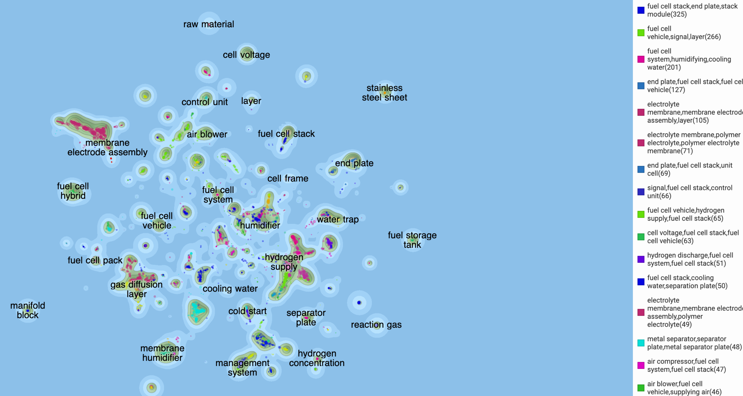
专利地图

Slide 17
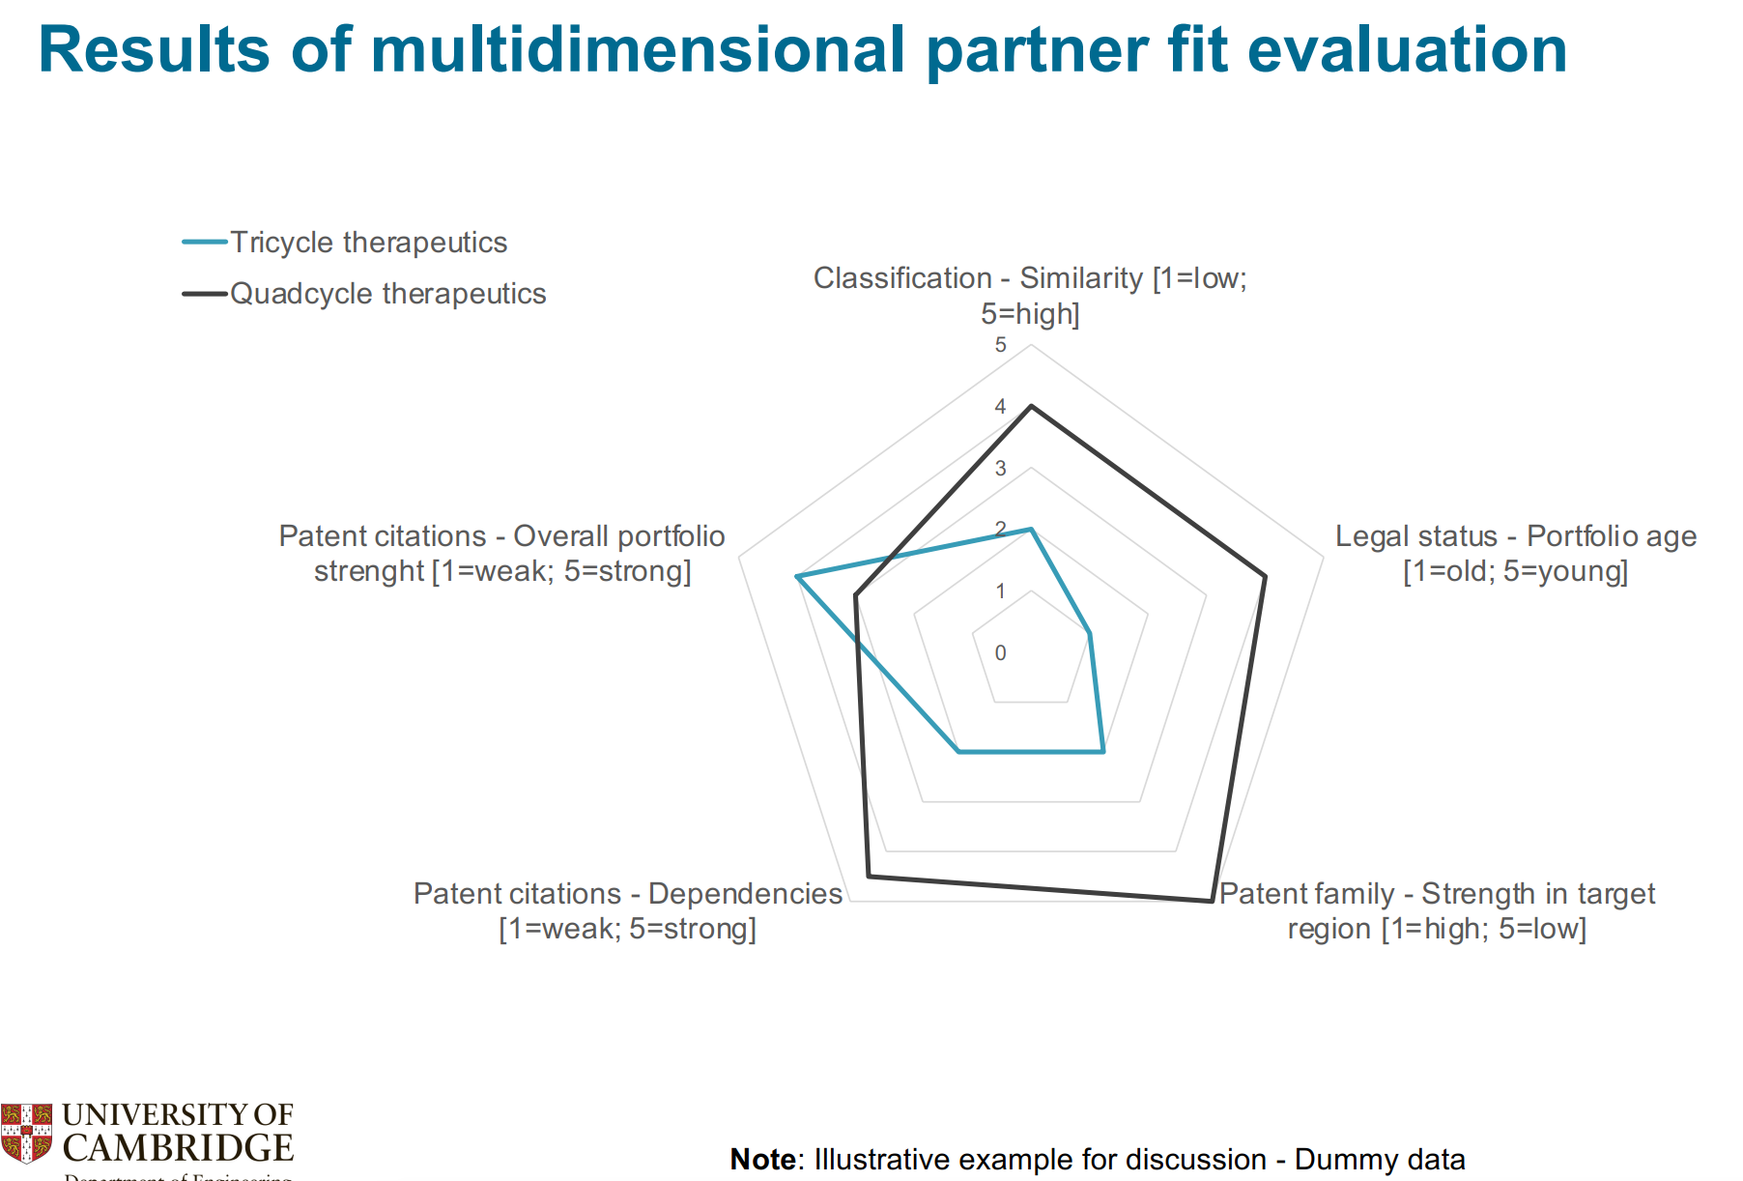
Classification - Similarity [1=low; 学长和Cui Can
Over 80%
50%~80%
没看懂
怎么给他打分？
Patent family - Strength in target miaomiao和我

Slide 18
潜在的limitation
General strategy
Eliminate “next”
Eliminate “Private owners”
具体要看为什么引用
Ballad 没有？
Should we consider next
Should we consider private owners?
问题3： 通过图3，学生理解是Tricycle是个更好的伙伴，因为他有着好的citation，并且通过下面两个条目，可以大致推断你出他与我家公司是互补的。学生这样理解对吗
向后引用。马老师说，有可能是专利审查员引用

Slide 19
结束

Slide 21
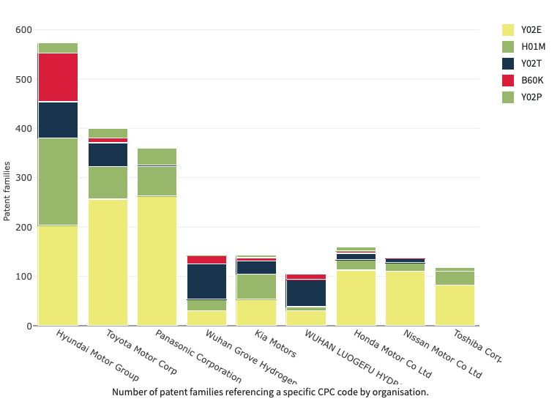
Six Selected CPC
Eliminate “next”
Eliminate “Private owners”
Hyundai Motor Group
Toyota Motor Group
Panasonic Corporation
Honda Motor Co Ltd
Y02E:
> 100
H01M:
> 50

Slide 22
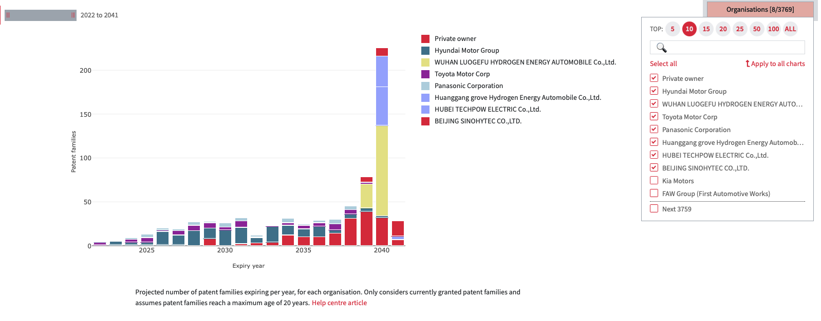
Projected number of patent families expiring per year, for each organisation. Only considers currently granted patent families and assumes patent families reach a maximum age of 20 years.

Slide 23
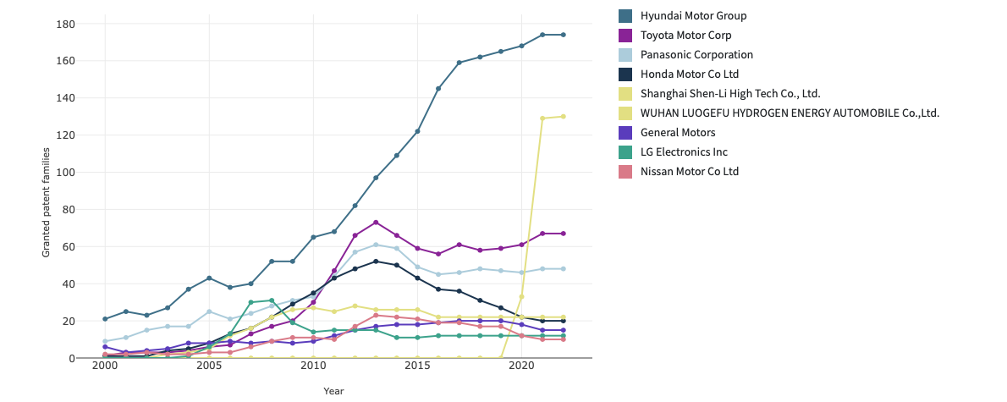
Figure 1. Number of patent families that are status granted in each year. A family is counted each year it remains alive from its grant year. Patent families are only counted for the years they are active.

Slide 24
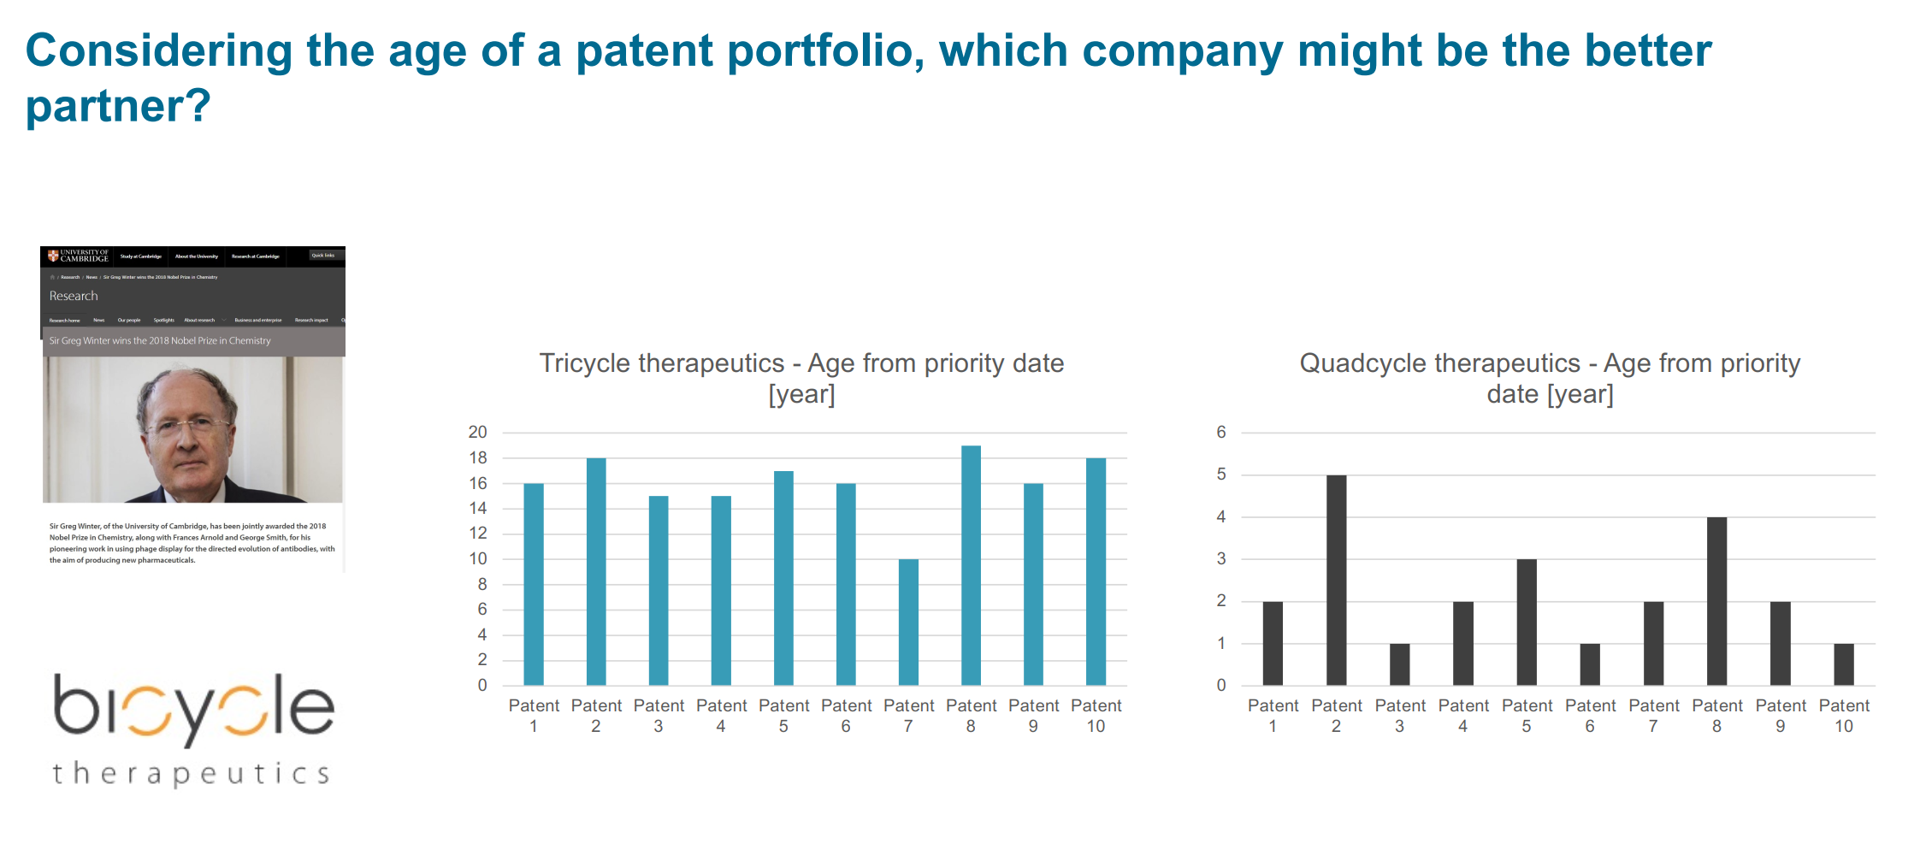
dt
问题1：从 Age of portfolio角度，该如何选择好伙伴呢？年限越大，后面可利用的时间就相对变短。但同时也意味这这家公司开始从业早，技术成熟。

Slide 25
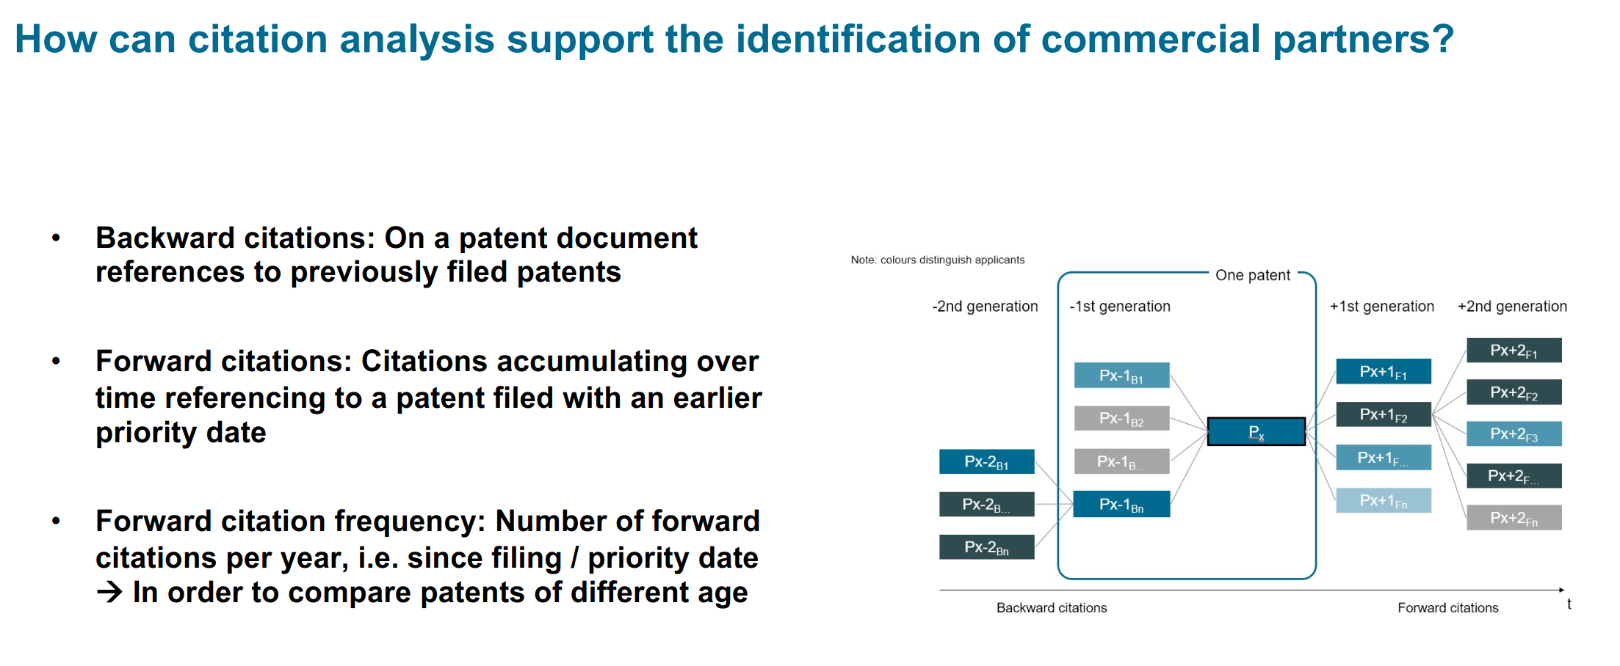
不大懂这个向前，向后引用。马老师说，有可能是专利审查员引用
问题2：所以说，向前引用数量越多，这个伙伴越好是嘛？

Slide 26
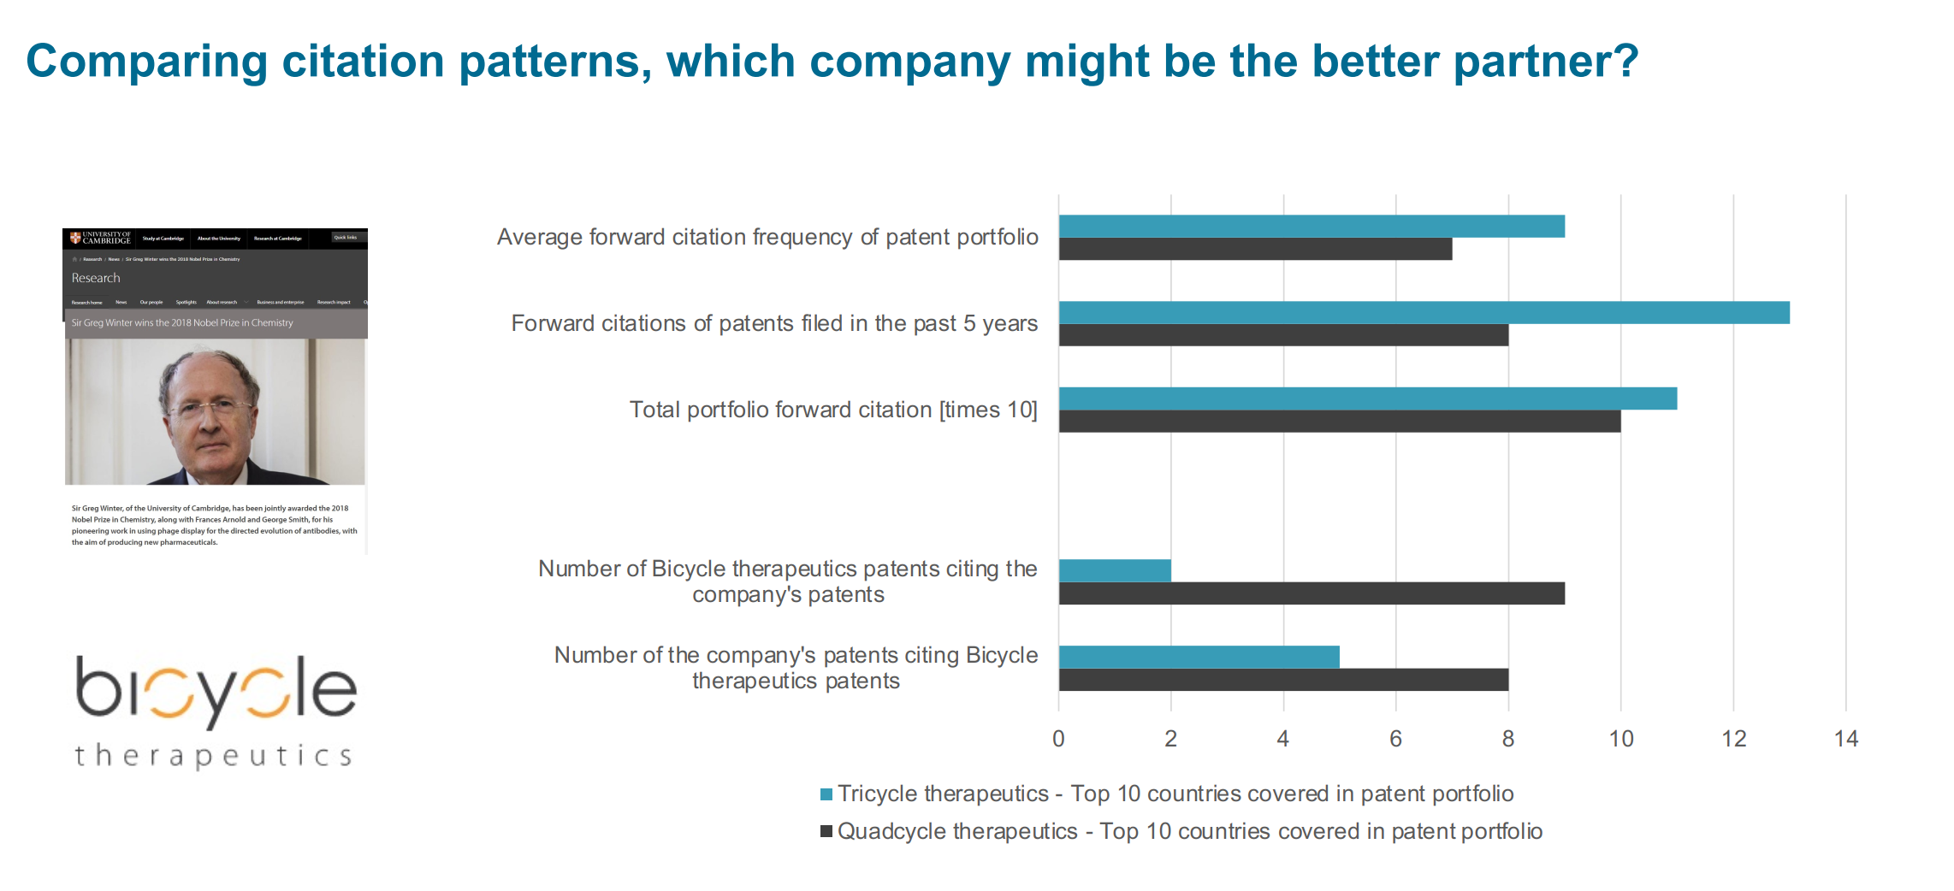
yc
问题3： 通过图3，学生理解是Tricycle是个更好的伙伴，因为他有着好的citation，并且通过下面两个条目，可以大致推断你出他与我家公司是互补的。学生这样理解对吗

